Slide 1


Slide 2
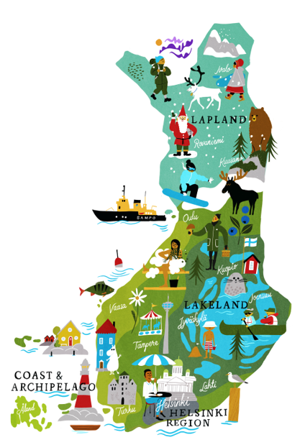
Finland – in the North of Europe
Capital city Helsinki
Approx. 5,5 million inhabitants
Neighbouring countries:
Sweden, Norway, Estonia and Russia
The happiest country in the world!
Almost 200 000 lakes, 4 beautiful seasons
Map: VisitFinland

Slide 3
UEF’s key figures
4
faculties
13
fields of study
100
major subjects
2,700
members of staff
15,500
degree students
23,300
adult education students
1,500
international
degree students
3,167
degrees awarded
in 2019
2,644
scientific
publications in 2019

Slide 4
The most multidisciplinary university in Finland
13
FIELDS OF STUDY
- widest selection in Finland
Pharmacy
Dentistry
Humanities
Education
Economics and business administration
Natural sciences
Medicine
Forest sciences
Law
Psychology
Theology
Health sciences
Social sciences

Slide 5
We are in the middle of knowhere
UEF
Kuopio
Joensuu

Slide 6
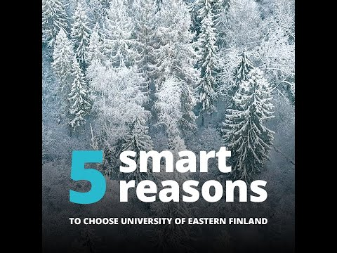

Slide 7
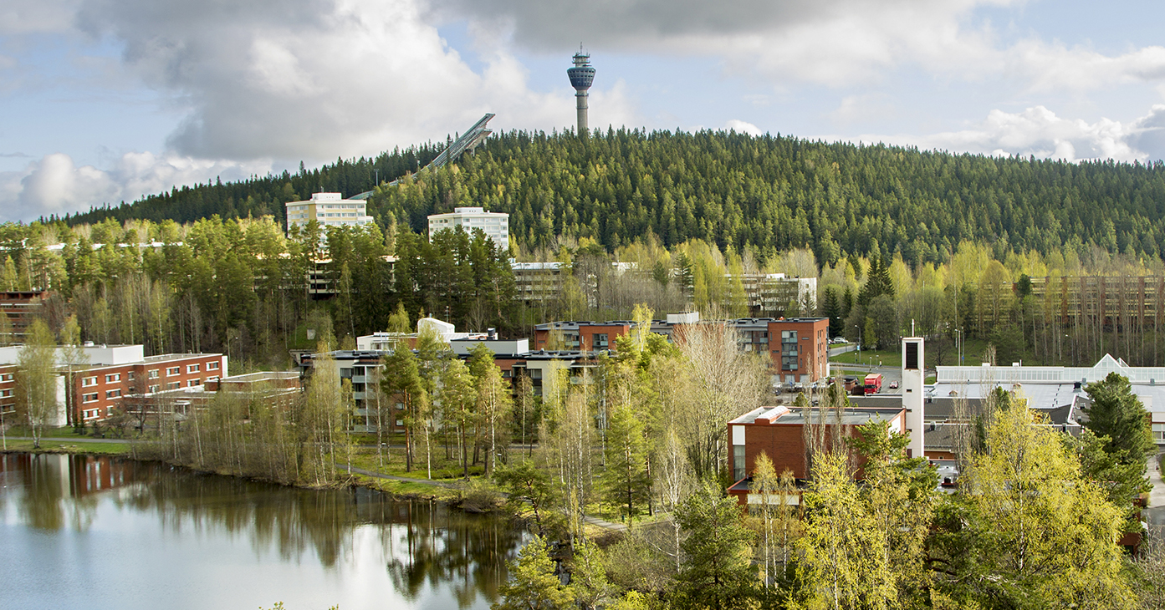
Kuopio
9th largest city in Finland
117 000 residents
6700 UEF students
The happiest people in Finland live in Kuopio
Picture: BusinessKuopio

Slide 8
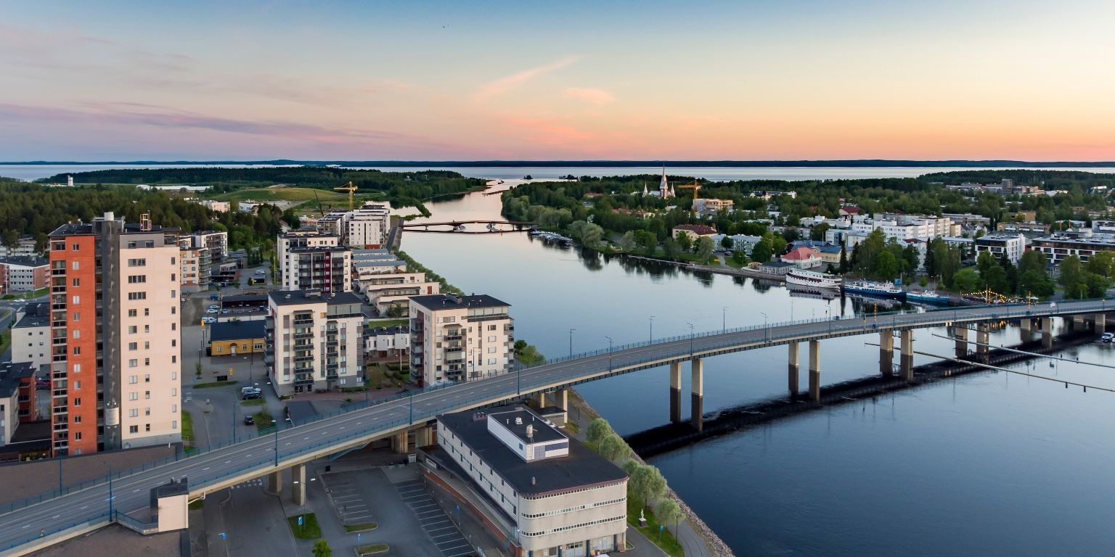
Joensuu
12th largest city in Finland
75 000 residents
9000 UEF students
Every 3rd resident is a student in Joensuu
Picture: City of Joensuu

Slide 9
Master’s Degree Programmes
One smart decision
UEF

Slide 10
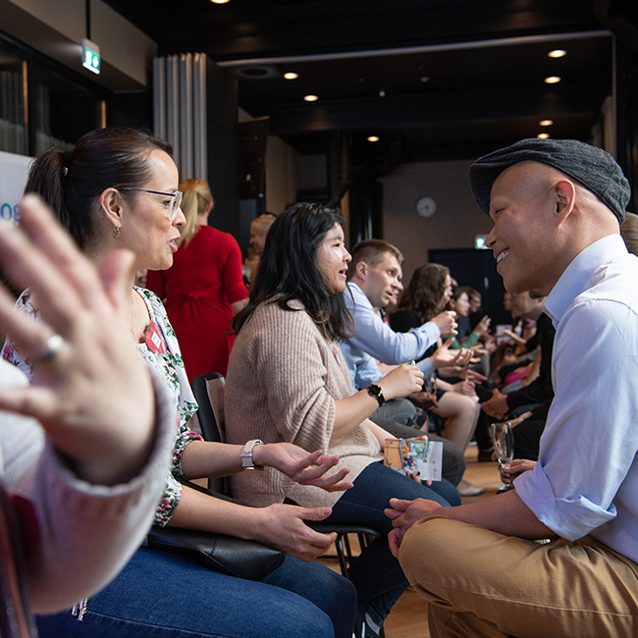
Master’s Degree Programmes
Natural and Health Sciences
Forestry, Environmental Policy and Law
International Business and Tourism
Education, Linguistics and English language
Over 20 international Master’s Degree Programmes + 2 Bachelor Degree Programmes coming

Slide 11

13
NATURAL AND HEALTH SCIENCES PROGRAMMES
“I love the multi-methods of teaching which use different tools, such as lectures, videos, and online teaching which helps students learn a lot better.” (Le Than Phuong, Environmental Health and Technology)
BIOLOGY // IT // PHOTONICS //
PUBLIC HEALTH…
NOW!
APPLICATION PERIOD IS
OPEN 2 DECEMBER – 22 JANUARY

Slide 12
// PROGRAMMES | CAMPUS | TUITION FEE | WAIVER | BACHELOR’S DEGREE OR EQUIVALENT
Biology of Environmental Change | JOENSUU & KUOPIO | 8 000 € | 70 % | Environmental or Biological Sciences
Information Technology | JOENSUU | 8 000 € | 70 % | Computer Science, Information Technology, Communications Engineering
Photonics | JOENSUU | 8 000 € | 70 % | Physics, Optics, Photonics, Physical and Engineering Sciences
Research Chemists | JOENSUU | 8 000 € | 70 % | Chemistry or Chemical Engineering
Wood Materials Science | JOENSUU | 8 000 € | 70 % | Chemistry, Biosciences/Life Sciences, Biotechnology, Forest Sciences, Suitable Engineering Studies, Applied Physics, Bioeconomy or Forest Products Marketing
Computational Color and Spectral Imaging (Erasmus Mundus) | JOENSUU | 9 000 € | Full and partial scholarships available​ | Computer Science, Optics, Physics, Mathematics, Signal Processing, Electronics, Cognitive Psychology
Imaging and Light in Extended Reality (Erasmus Mundus) | JOENSUU | 8 000 € | Full and partial scholarships available​ | Computer Science, Information Technology, Electrical Engineering, Photonics
Photonics for Security, Reliability and Safety (Erasmus Mundus) | JOENSUU | 9 000 € | Full and partial scholarships available | Engineering, Computer Science or Physics.
Environmental Health and Technology | KUOPIO | 8 000 € | 70 % | Environmental or Biological Sciences including Human Biology and Physics or Chemistry
Medical Physics | KUOPIO | 8 000 € | 70 % | Science or Engineering including Physics and Mathematics. Computer Programming and Human Biology are considered an asset
Biomedicine | KUOPIO | 10 000 € | 70 % | Biochemistry, Cell Biology, Molecular Biology, Bioinformatics, Biomedicine
Public Health | KUOPIO | 10 000 € | 70 % | Public Health, Medicine, Dentistry, Nutrition, Pharmacy, Psychology, Nursing, Midwifery, Veterinary Medicine, Environmental Sciences and Social Sciences
General Toxicology | KUOPIO | 10 000 € | 70 % | Medicine, Biology, Biosciences, Veterinary Medicine, Dentistry, Environmental Sciences, Animal Physiology, Pharmacy, Biochemistry and Chemistry. Studies in Human Anatomy, Physiology, Pharmacology and Toxicology are mandatory
NOW!
APPLICATION PERIOD IS
OPEN 2 DECEMBER – 22 JANUARY

Slide 13

4
FORESTRY + ENVIRONMENTAL POLICY AND LAW PROGRAMMES
UEF´s Top Fields of Research
Atmospheric science (42 in ARWU // Nursing (76-100 in ARWU) // Dentistry and Oral Sciences (101-150 in ARWU) // Biological sciences (101-150 in ARWU) // Forestry (151-200 in QS) // Hospitality and Tourism (151-200 in ARWU)
ENVIRONMENTAL POLICY & LAW // FORESTRY //
NOW!
APPLICATION PERIOD IS
OPEN 2 DECEMBER – 22 JANUARY

Slide 14
FORESTRY + ENVIRONMENTAL POLICY AND LAW PROGRAMMES
// PROGRAMMES | CAMPUS | TUITION FEE | WAIVER | BACHELOR’S DEGREE OR EQUIVALENT
Joint Nordic Master Programme in Environmental Law | JOENSUU | 8 000 € | 50 % | Min 90 ECTS in legal science
Forestry | JOENSUU | 8 000 € | 70 % | Forest Sciences
European Forestry (Erasmus Mundus) | JOENSUU | 8 500 € | Full and partial scholarships available​ | Forestry
Environmental Policy and Law | JOENSUU | 8 000 € | 70 % | Environmental Sciences, Social-scientific Environmental studies, Natural Sciences or Environmental Engineering, appropriate field in Social Science or Law
NOW!
APPLICATION PERIOD IS
OPEN 2 DECEMBER – 22 JANUARY

Slide 15
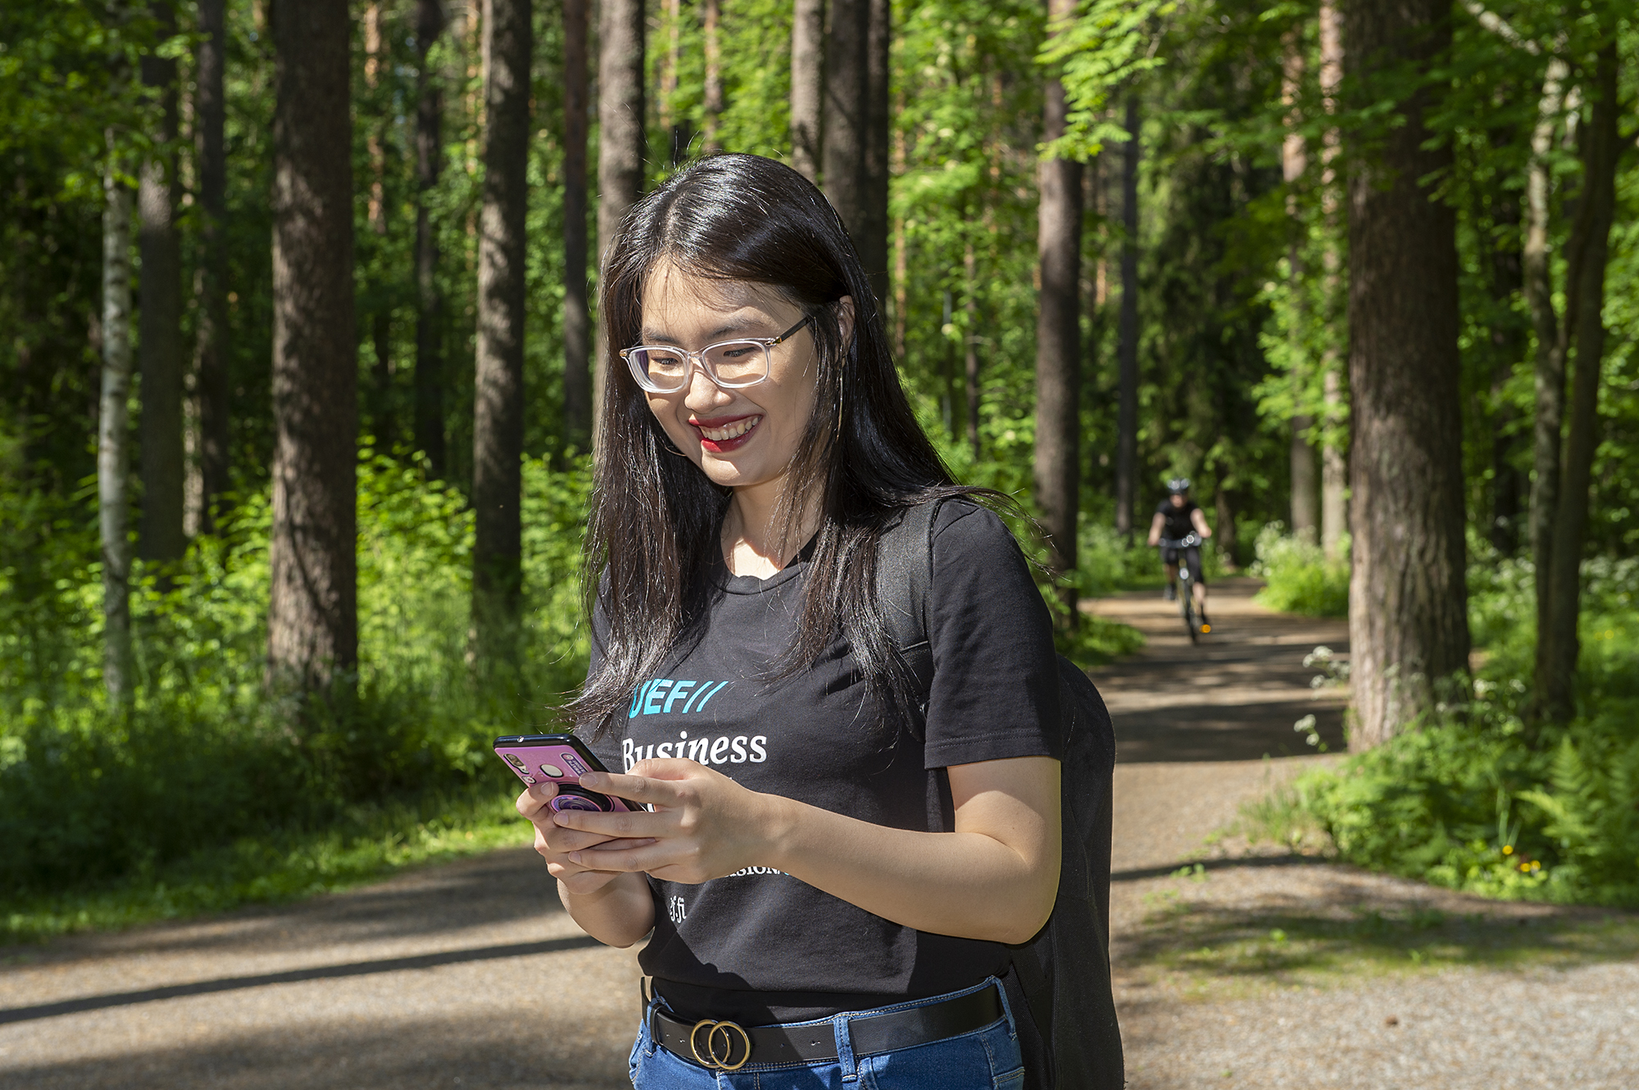
2
INTERNATIONAL BUSINESS, SALES AND TOURISM PROGRAMMES
TOURISM MARKETING AND MANAGEMENT
&
INTERNATIONAL BUSINESS SALES AND MANAGEMENT
“Master's Degree Programme in Tourism Marketing and Management is not only about making money; we aim to make tourism better.”
NOW!
APPLICATION PERIOD IS
OPEN 2 DECEMBER – 22 JANUARY

Slide 16
INTERNATIONAL BUSINESS, SALES AND TOURISM PROGRAMMES
// PROGRAMMES | CAMPUS | TUITION FEE | WAIVER | BACHELOR’S DEGREE OR EQUIVALENT
Tourism Marketing and Management | JOENSUU | 8 000 € | 50 % | Tourism or Business (min 60 ECTS tourism and/or business studies)
International Business and Sales Management | KUOPIO | 8 000 € | 50 % | Business (min 60 ECTS business studies)
NOW!
APPLICATION PERIOD IS
OPEN 2 DECEMBER – 22 JANUARY

Slide 17

5
EDUCATION, LINGUISTICS AND ENGLISH LANGUAGE PROGRAMMES
Development of learning environments is UEF´s one of most important goals – the best in Finland!
Learning methods: i.e. Flipped learning, digital learning and flexible pedagogical solutions
VERSATILE LEARNING ENVIRONMENTS
NOW!
APPLICATION PERIOD IS
OPEN 2 DECEMBER – 22 JANUARY

Slide 18
EDUCATION AND LINGUISTICS
// PROGRAMMES | CAMPUS | TUITION FEE | WAIVER | BACHELOR’S DEGREE OR EQUIVALENT
Early Language Education for Intercultural Communication | JOENSUU | 8 000 € | 70 % | Foreign language
Pedagogy and Teaching for Sustainability | JOENSUU | 8 000 € | 70 % | Applicable Bachelor’s degree including studies in education
Clinical Linguistics (Erasmus Mundus) | JOENSUU |  | Full and partial scholarships available​ | Speech and language pathology, Linguistics, Biomedical sciences, Psychology, Special education
English Language and Culture | JOENSUU | 8 000 € | 70 % | English Language and Literature, English Linguistics or English Translation
Linguistic Data Sciences | JOENSUU | 8 000 € | 70 % | Linguistics, Language studies or Translation studies
NOW!
APPLICATION PERIOD IS
OPEN 2 DECEMBER – 22 JANUARY

Slide 19
Tuition fees and waivers
Tuition fees:
8 000-10 000 € per academic year
Tuition waivers: 50-70 %
5 Erasmus Mundus Programmes with full and partial scholarships
www.uef.fi/masters

Slide 20
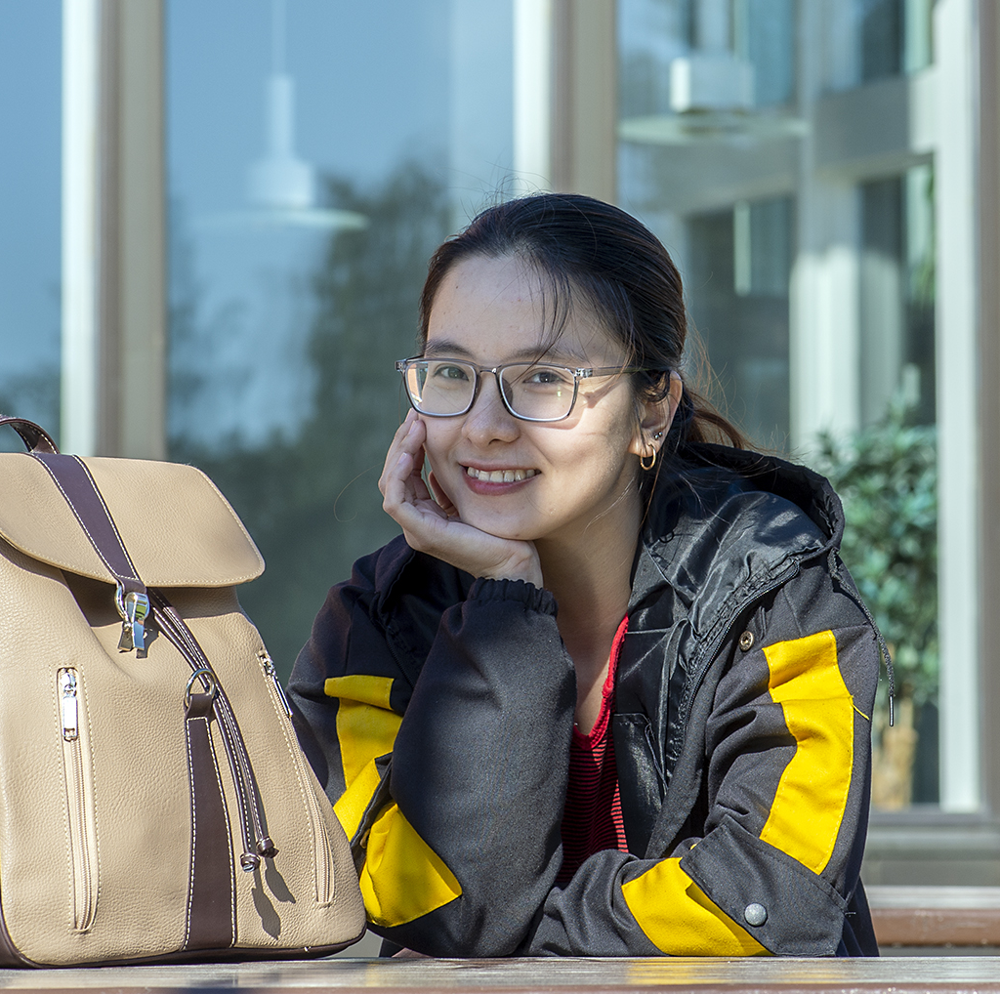
Applying to UEF
Eligibility:
  Bachelor’s Degree (or graduating student)
  Proof of English language skills (i.e. IELTS)
  Programme specific requirements
The next application period:
End of 2021
  Applications via national Studyinfo online portal
  Results by e-mail in March 2022
  Studies start in September 2022

Slide 21
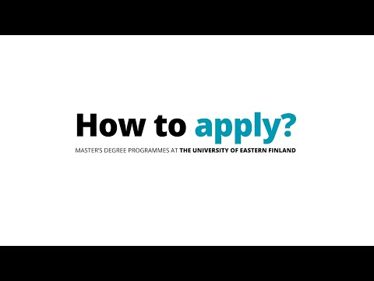

Slide 22
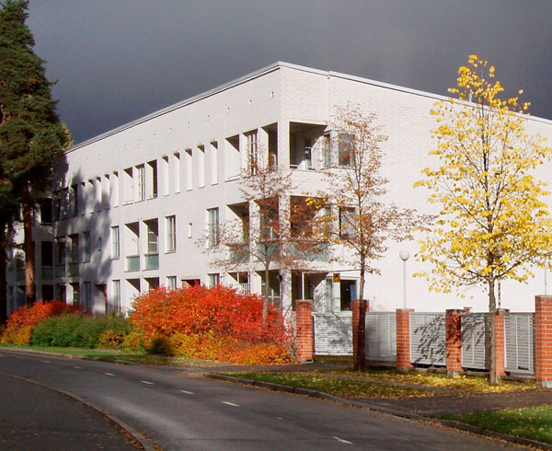
Student housing
Located around the city
  No on-campus living
Apartment types
  Shared flats, studios, family apartments
  Non-furnished
Rent
  Shared flat appr. 170-350 € / month
Apply as soon as possible
  Joensuun Elli & Kuopas

Slide 23
Your time in Finland will be an experience you will
not forget!
you

Slide 24

Why to choose
UEF?

Slide 25
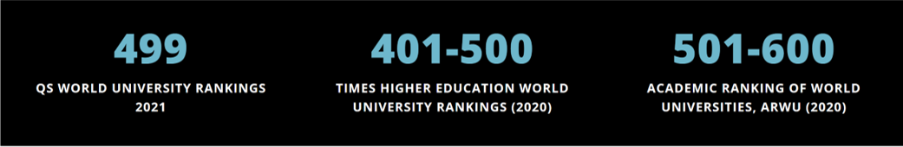
We are ranked among
the world’s finest.
you
UEF is globally within the best 2 %.

Slide 26
Research, education & labour market
Over 80 % of UEF students had a job in next spring after graduation
(UEF survey 2019)
  All UEF programmes included (International & Finnish)
We engage in close interaction with companies and our stakeholders.
UEF trains highly skilled experts for labour market needs.
Impact
Research
Education

Slide 27

A smart move towards the career of your dreams
Gain competitive advantage through a degree from one of Finland’s leading universities​
Our Master’s level courses are often taught in small groups, enabling close student-teacher interaction. ​
Many of our Master’s degree students stay on board at UEF to continue their studies in our doctoral programmes.

Slide 28
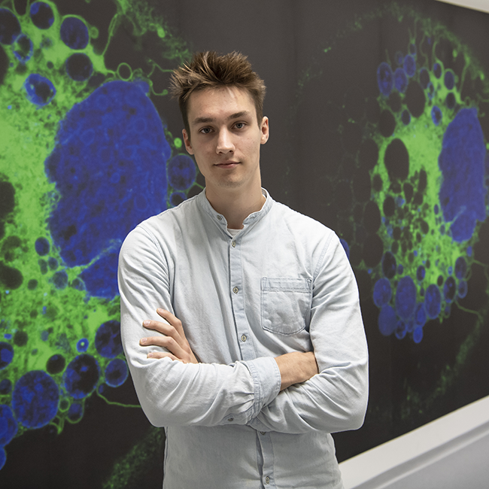
Evolving learning environments
Inspiring, open and continuously evolving learning environments.
Comfortable facility solutions and modern digital environments support learning.
Multi-modal and flexible teaching.

Slide 29
UEF is Finland’s most multidisciplinary university.
you
A learner-centred university,
flexible study opportunities and unique learning environments.
Safe & international environment.
Great fit for nature lovers!
Reasonable tuition fees and living costs.

Slide 30

Thank you!
uef.fi

